Slide 1
Comparison of univariate Time series prediction methods
Maggie Sleziak Sallee
SEA SCIENTIFIC SOFTWARE CONFERENCE AND TUTORIALS 2019
Improving Scientific Software
April 8 - 12, 2019

Slide 2
GOALS
Time Series Prediction
Explore different models to find optimal prediction fit for an univariate time series.
Time Series:
Daily temperature average from the weather station at the Denver International Airport for January 1, 2010 to August 26, 2018. (3160 values)
Dataset from:
National Centers for Environmental Information, NCEI. Climate Data Online. Retrieved from https://www.ncdc.noaa.gov/cdo-web/

Slide 3
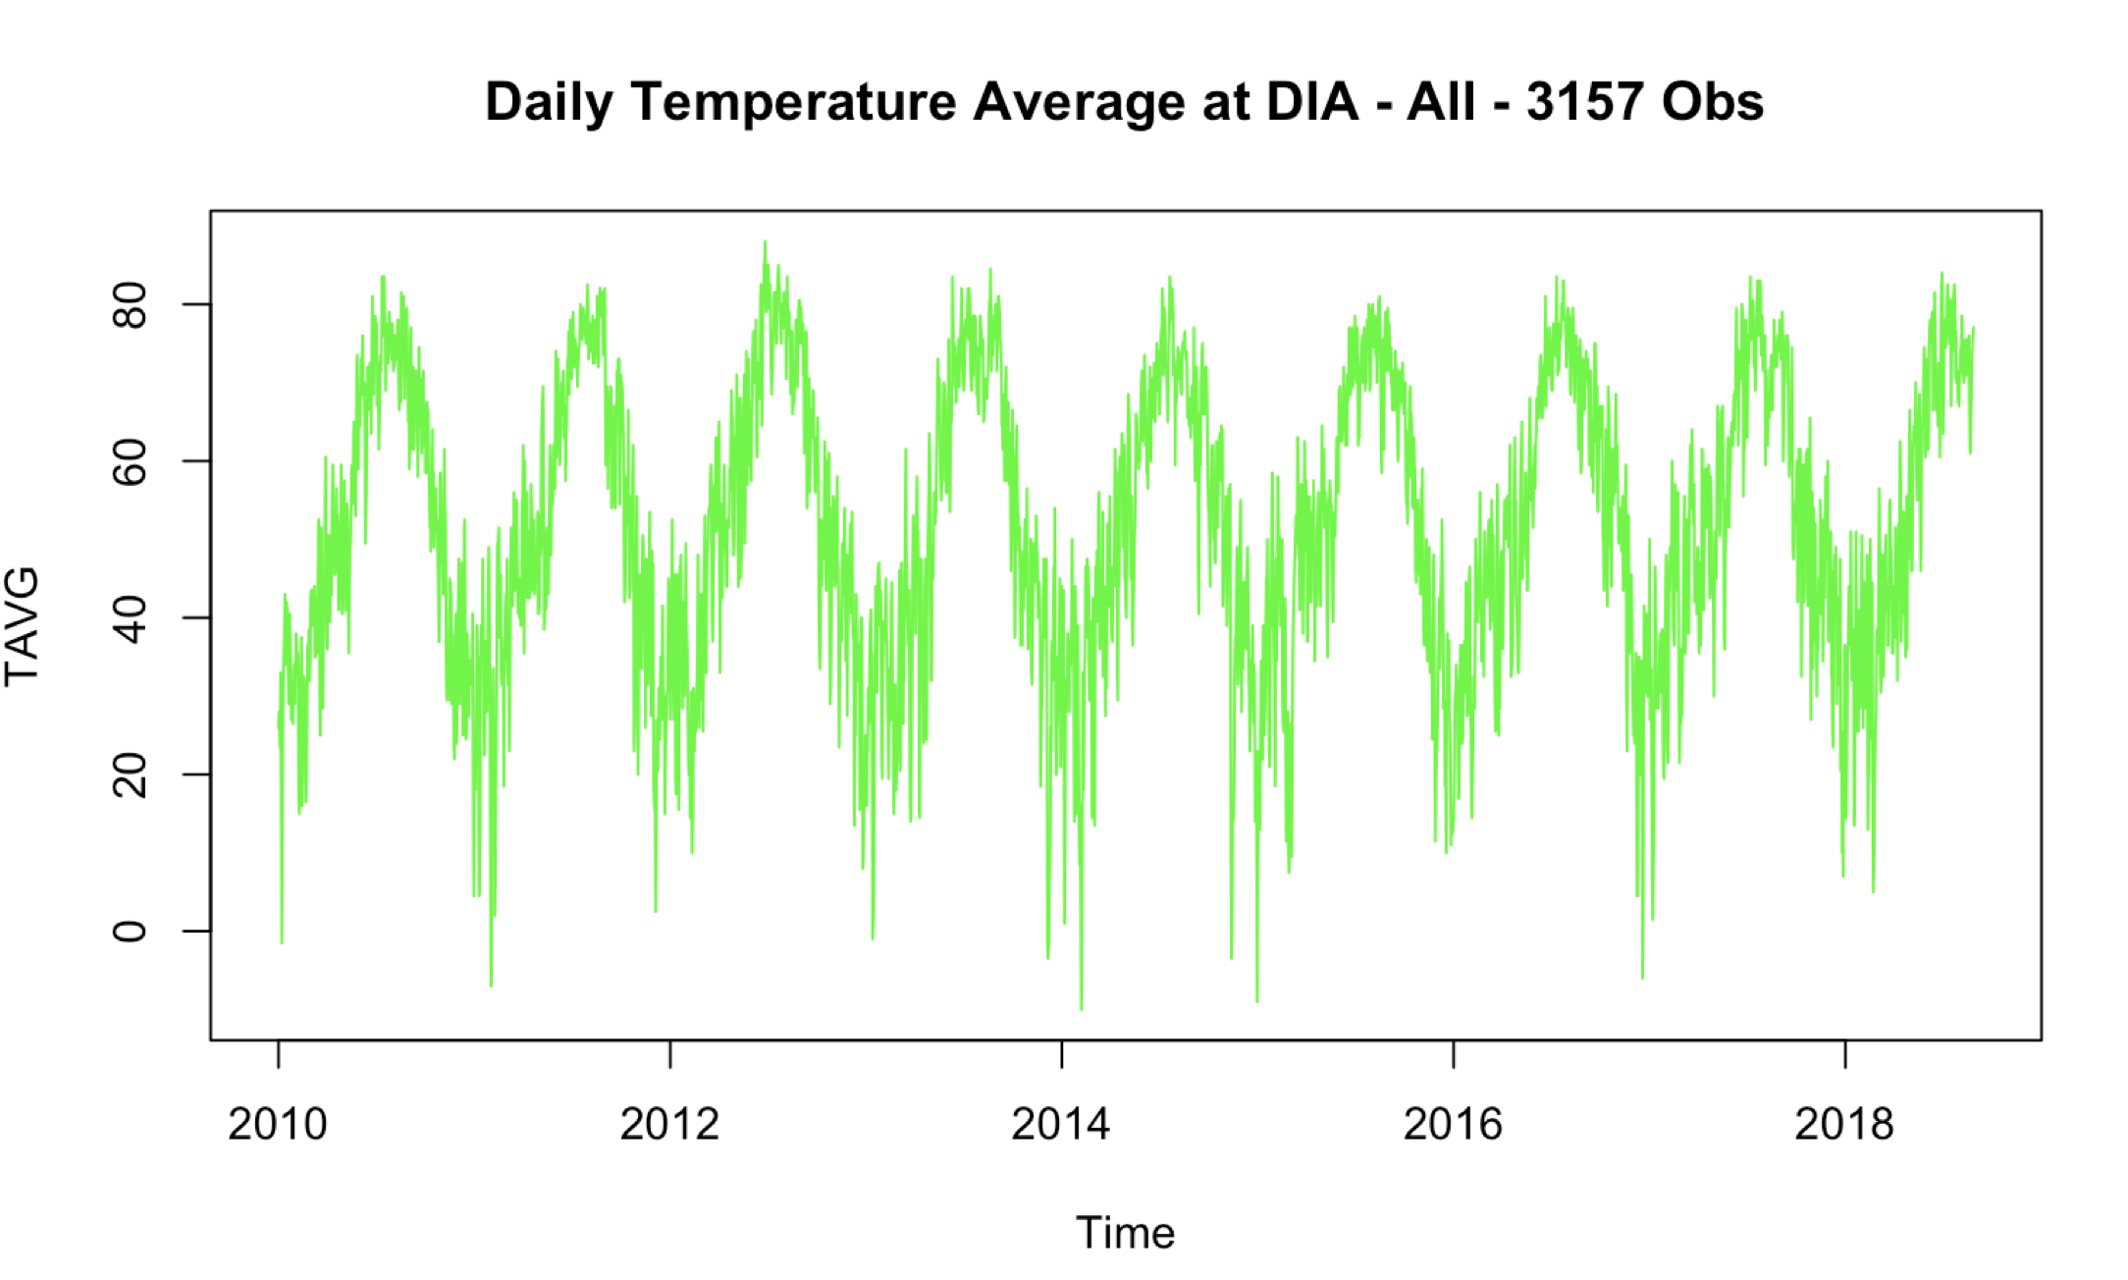
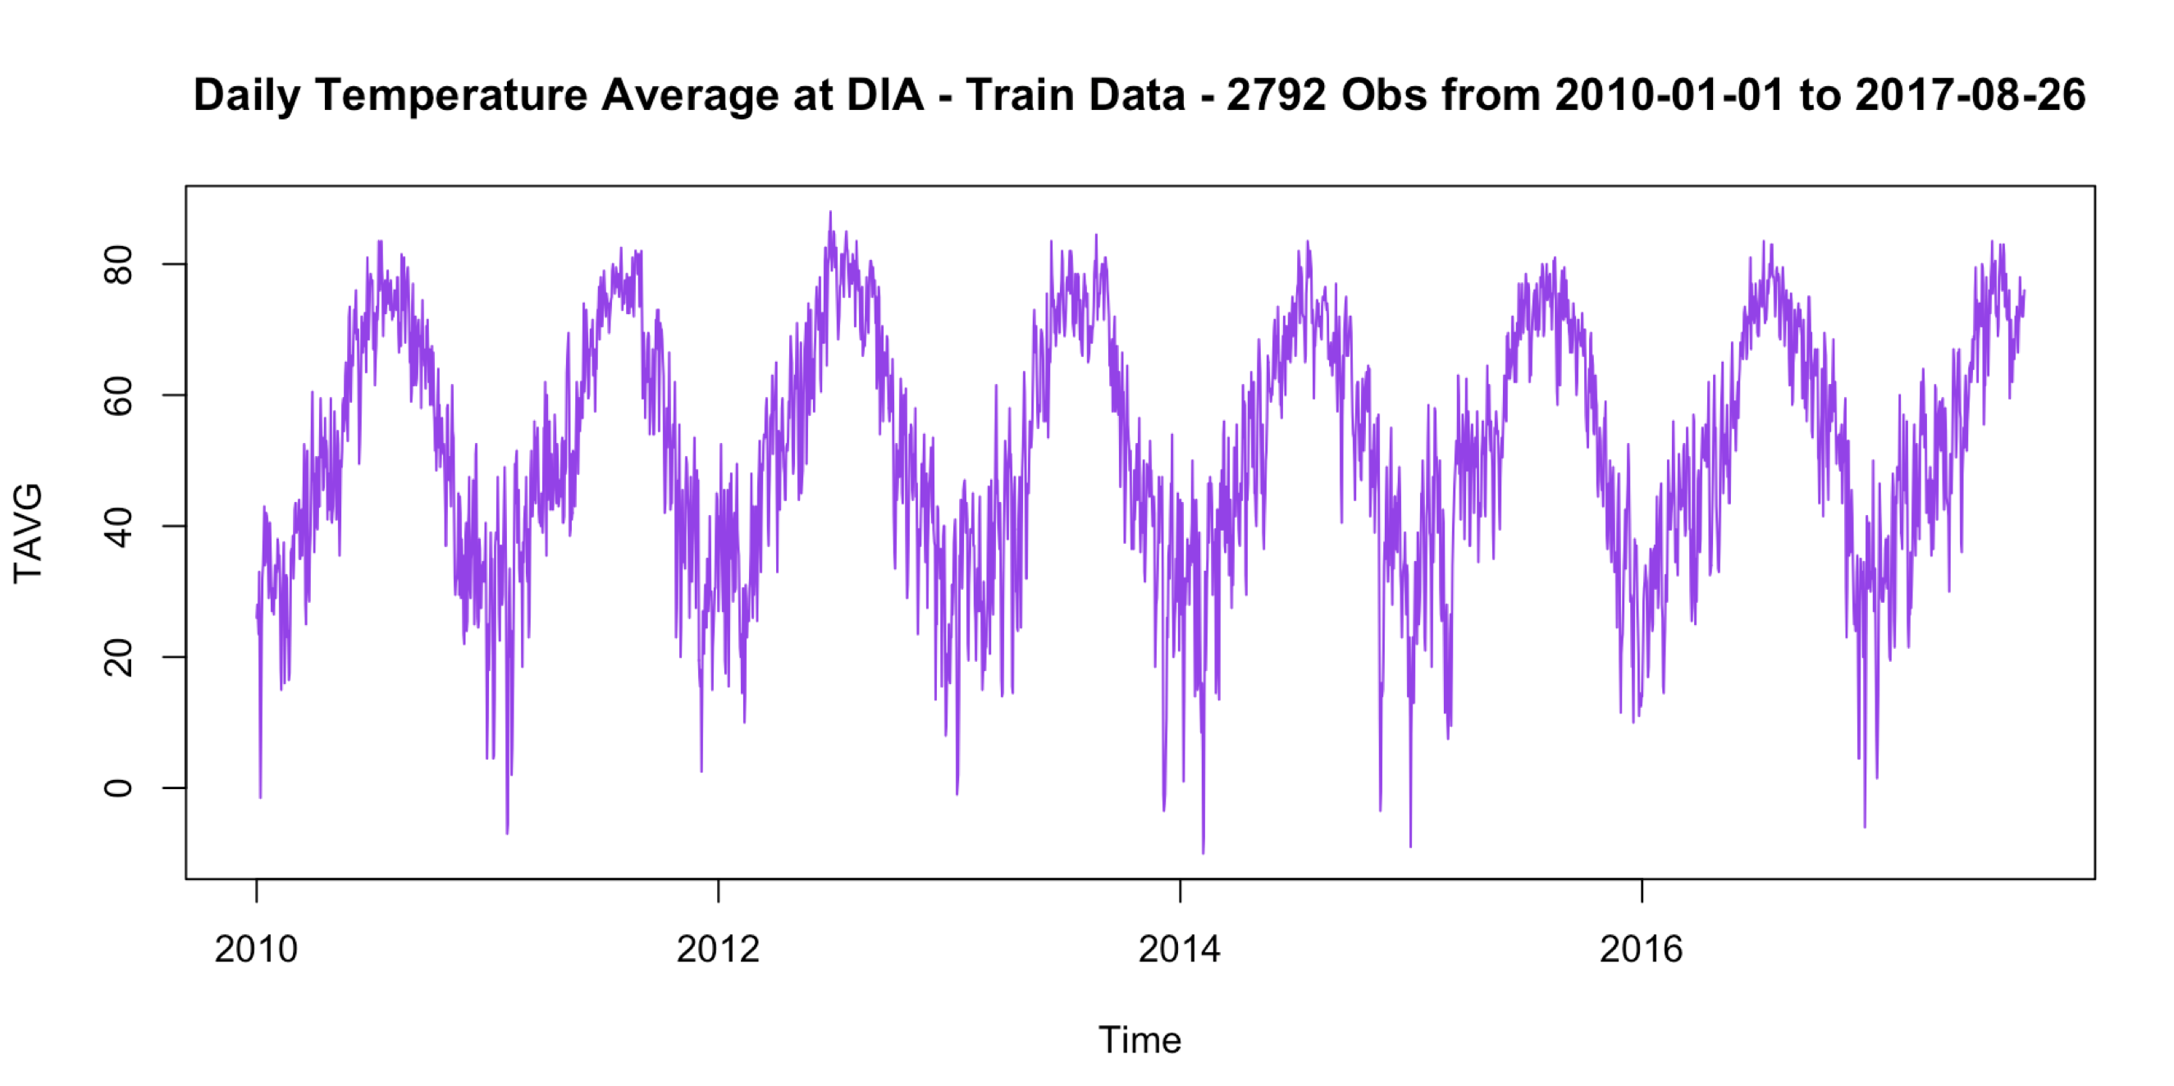
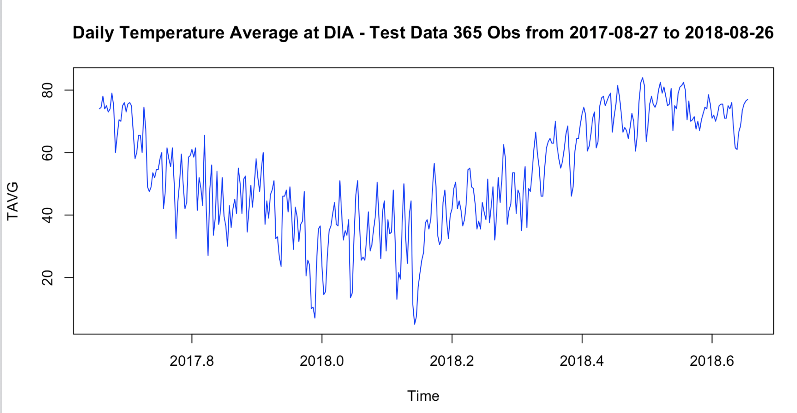
Dividing the data into Train and Test Data sets

Slide 4
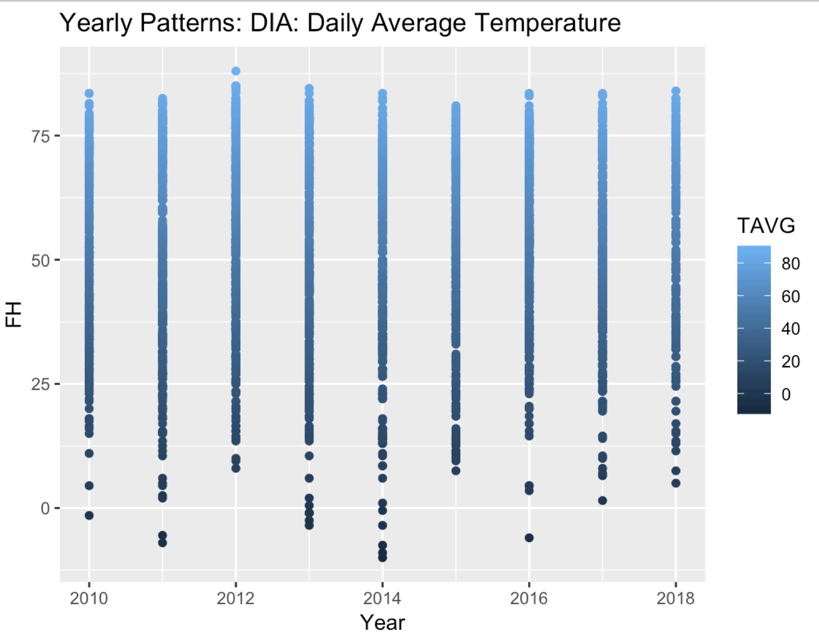
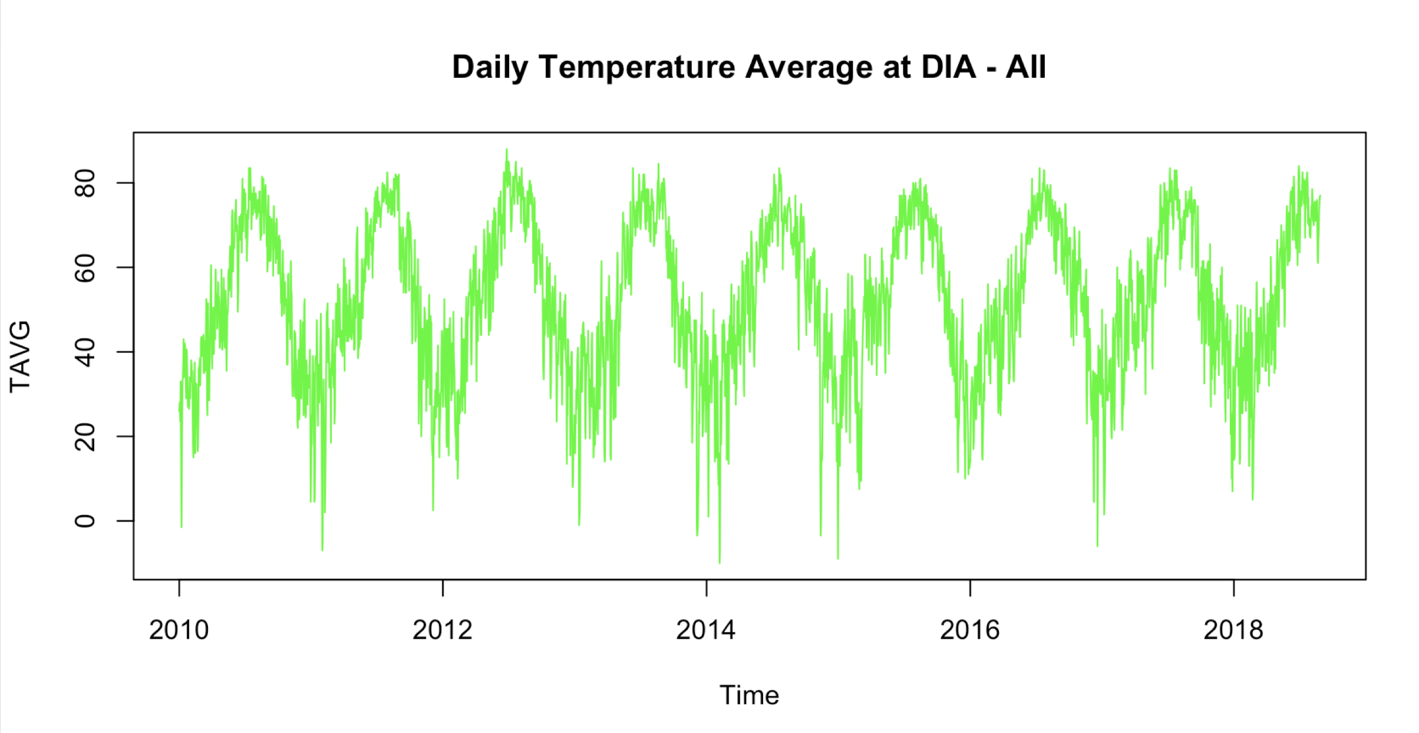
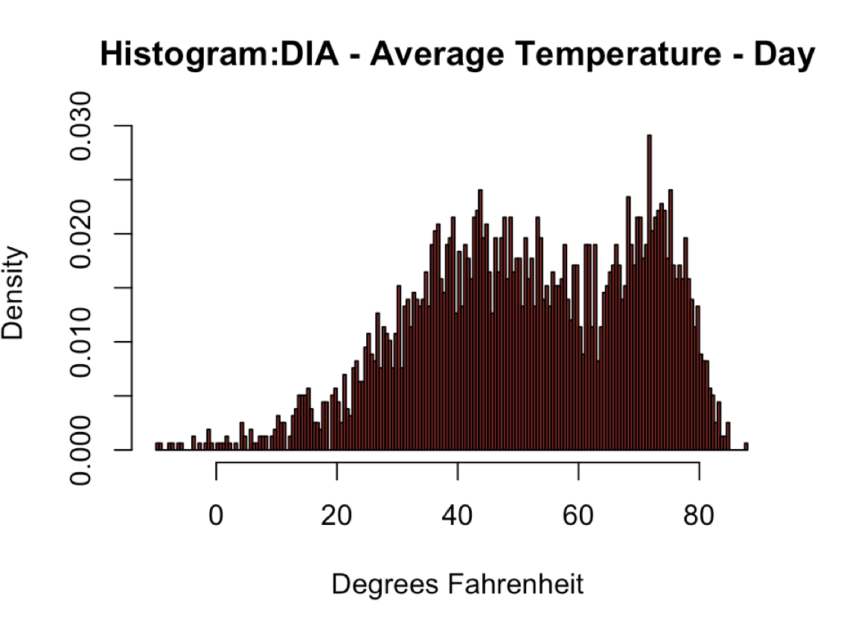
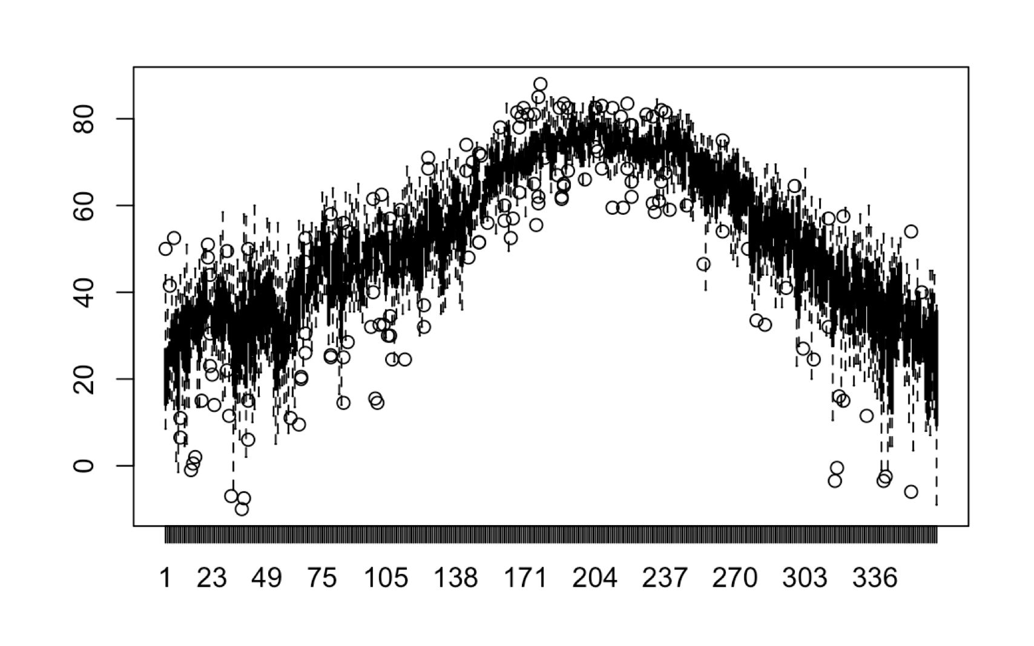
Data
Box plot across the months to explore seasonal effect
Gaussian with slightly bimodal distribution

Slide 5
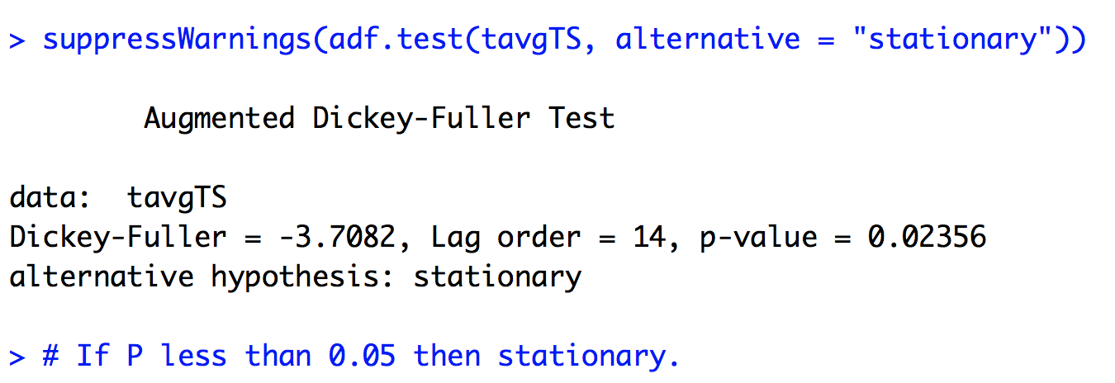
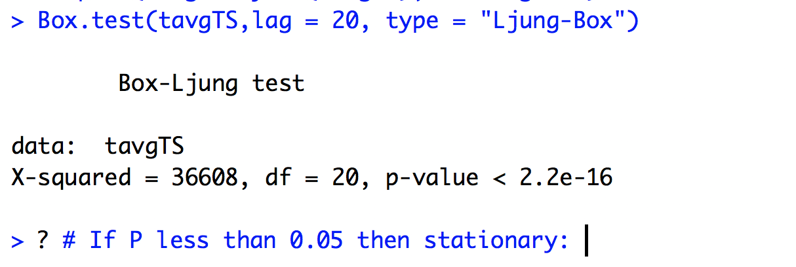
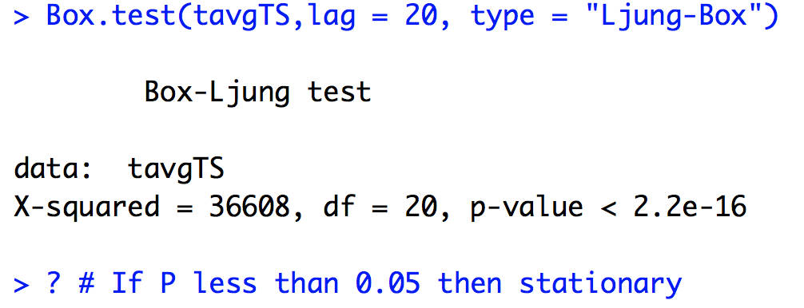
Data Stationarity Tests –
Based on these tests, data is stationary.

Slide 6
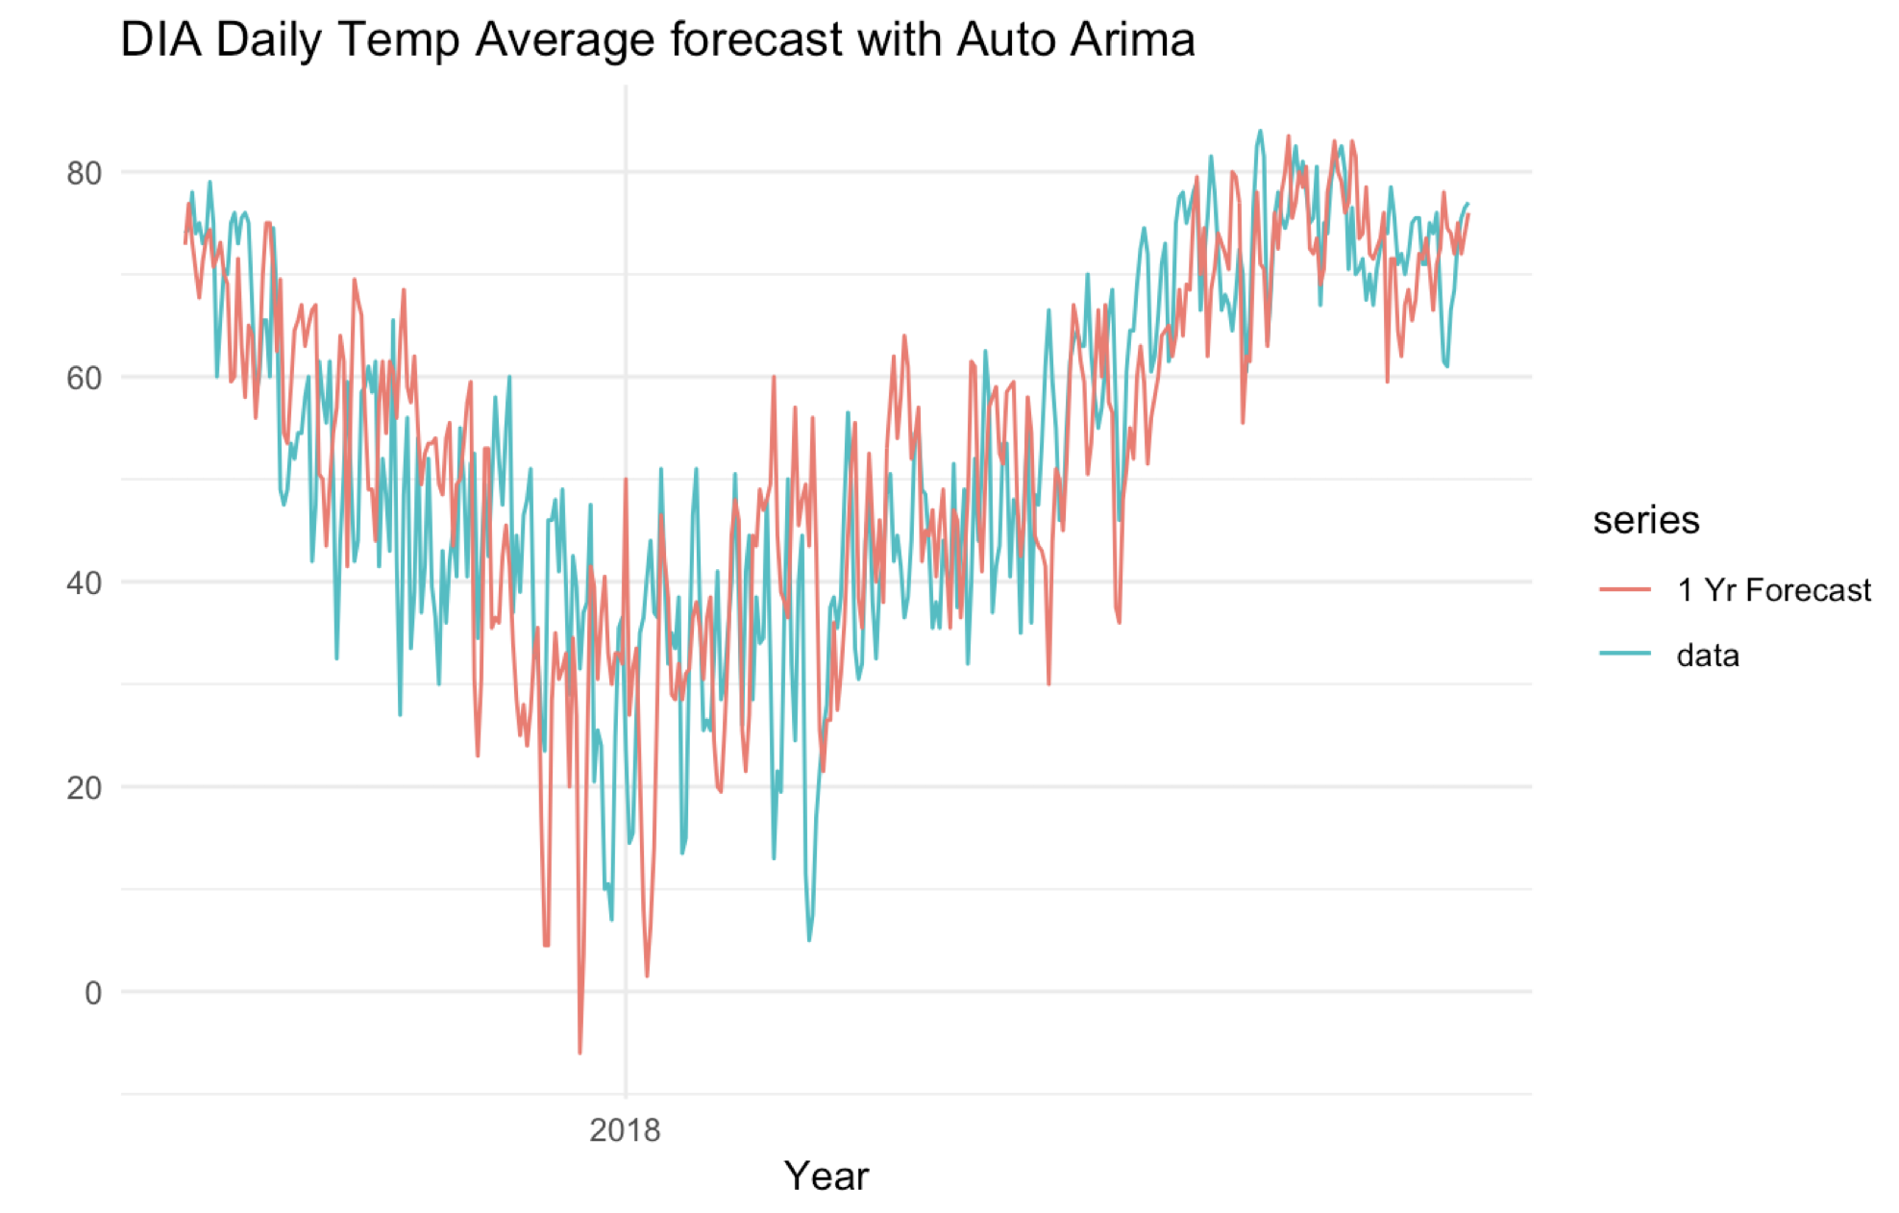
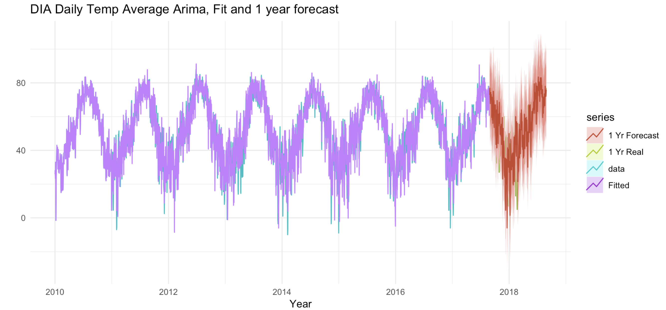
AUTO.ARIMA – forecast
ARIMA(3,0,0)(0,1,0)[365]
fit_autoH <- auto.arima(trainSetTS)
# Forecast for one year
autoHForecast <- forecast(fit_autoH, h=365)
(3 lags)
Train RMSE: 8.873844 Test (mean) RMSE: 13.04692

Slide 7
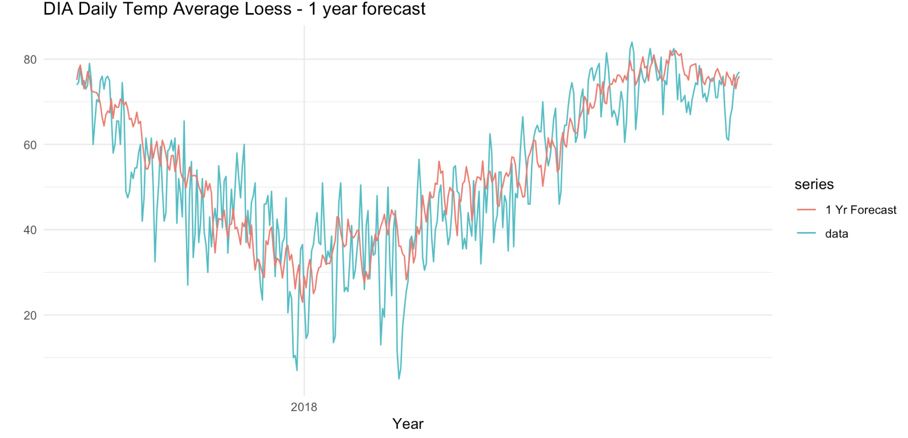
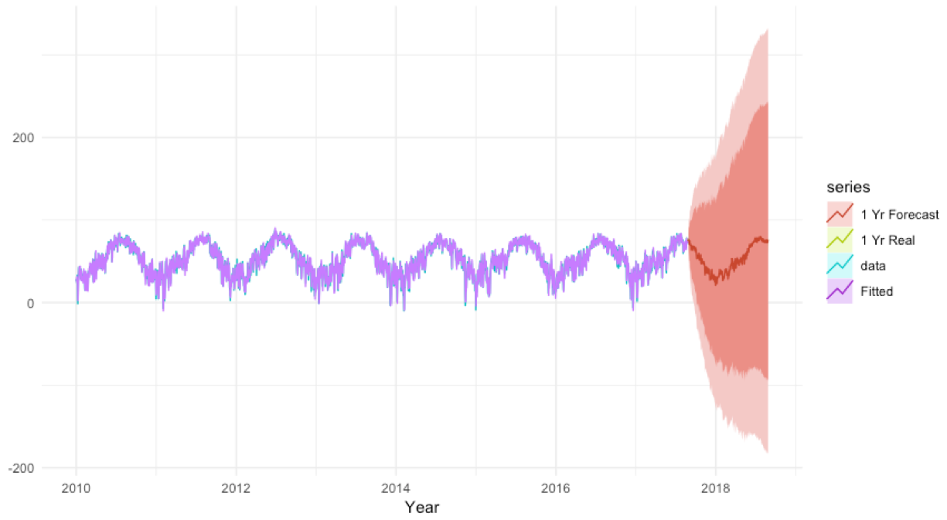
lOESS 1 Year forecast
STL Decomposition: Seasonal and trend decomposition using Loess smoothing.
loessModel <- stlf(trainSetTS, h=365, s.window=356)
RMSE: 9.802495
Train RMSE: 6.669228 Test RMSE: 9.802495

Slide 8
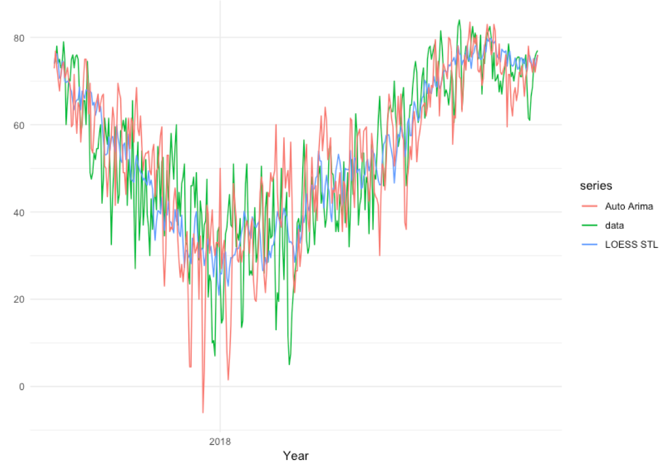
Both ARIMA and LOESS forecasts
Forecast – 1 Year | RMSE
LOESS – STL in R | 9.802
Auto Arima in R | 13.046

Slide 9
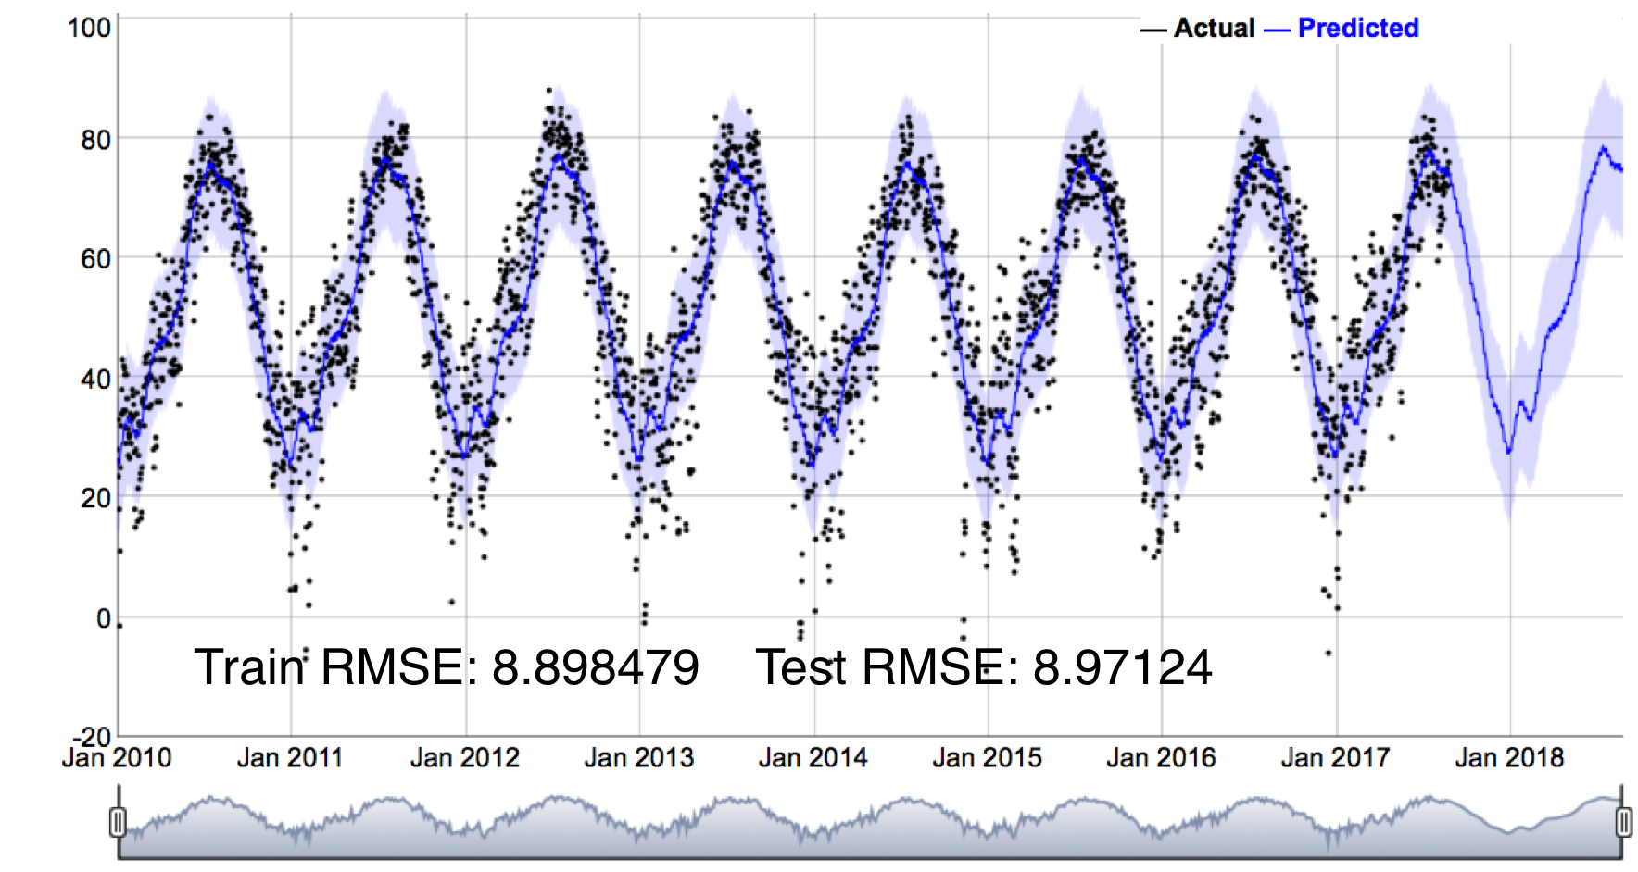
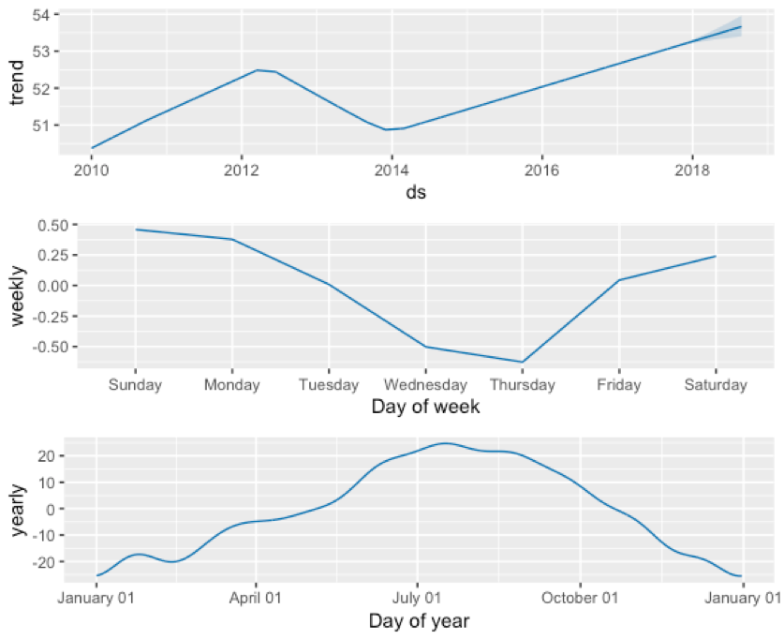
FORECAST using PROPHET
At its core, the Prophet procedure is an additive regression model with :
A piecewise linear or logistic growth curve trend.
Prophet automatically detects changes in trends by
selecting changepoints from the data.
A yearly seasonal component modeled using Fourier series.
A weekly seasonal component using dummy variables.
model7 <- prophet(as.data.frame(trainSet))
future <- make_future_dataframe(model7, periods = testDays+1, include_history = TRUE)
forecast <- predict(model7, future)

Slide 10
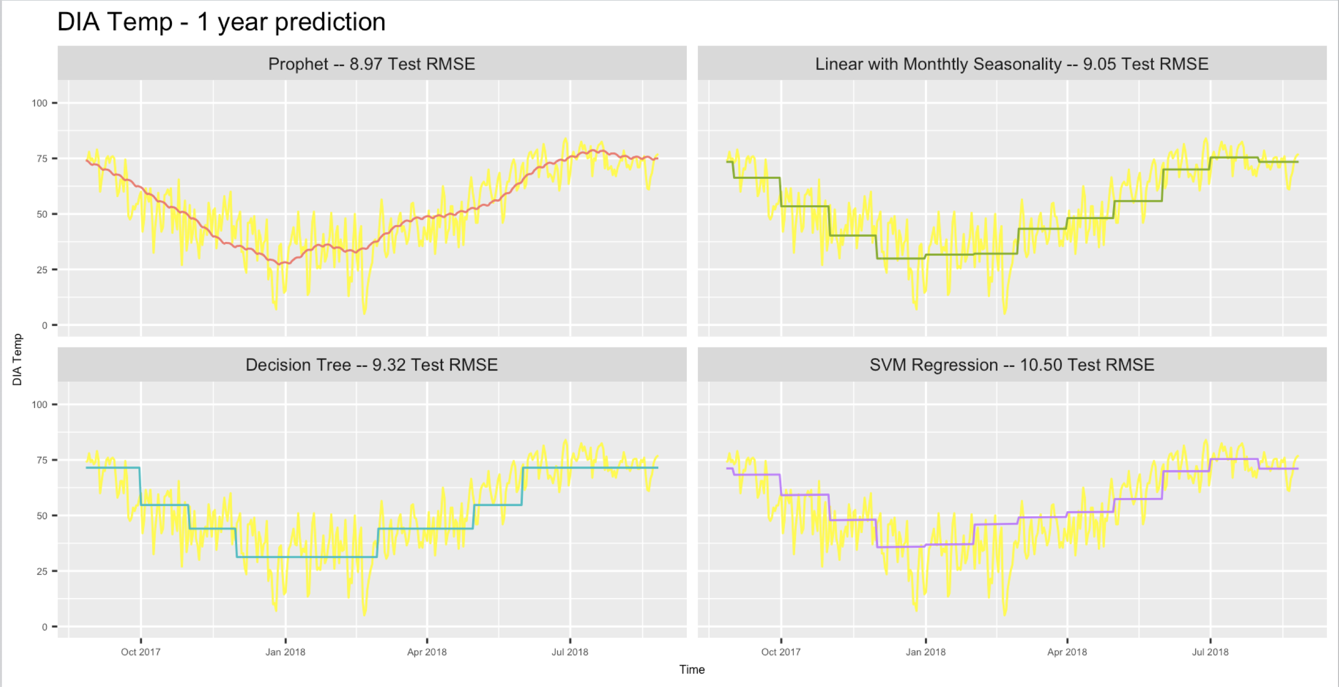
OTHER models
trainSet$pred <- predict(model)
testSet$pred <- predict(model,newdata = testSet)

Slide 11
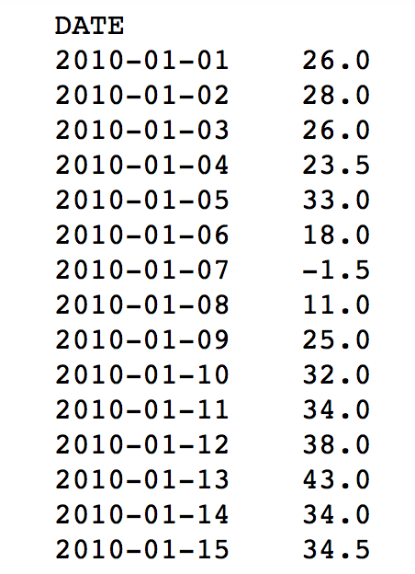
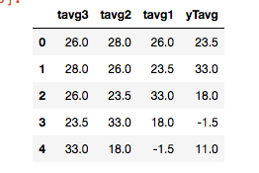
CONVERT to A supervised problem
Set 3 days of data as features and set target as the current day.
Analogous to one step ahead forecast
List of regressors to fit
modelsToFit = []
modelsToFit.append(('Gradient Boosting Regressor ', 'Gradient Boost', GradientBoostingRegressor(n_estimators=400)))
modelsToFit.append(('Linear Regression ', 'LR', LinearRegression()))
modelsToFit.append(('K Neighbors Regressor', 'KNN', KneighborsRegressor(n_neighbors=23)))
modelsToFit.append(('Support Vector Regressor ', 'SVR', SVR()))
modelsToFit.append(('Extra Trees Regressor ', 'Extra Tree', ExtraTreesRegressor()))
modelsToFit.append(('Random Forest Regressor', 'Radom Forest', RandomForestRegressor()))

Slide 12
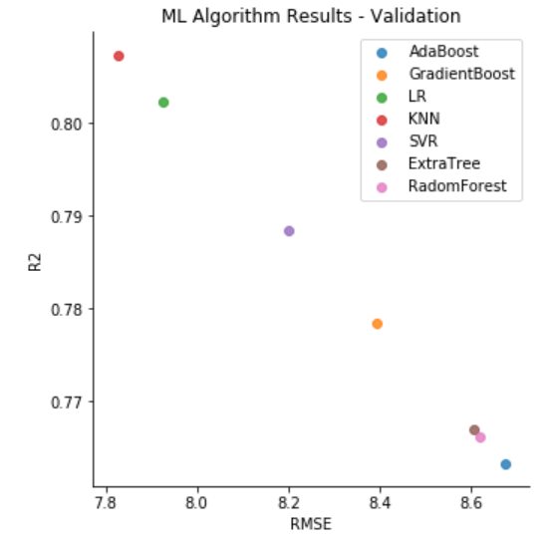
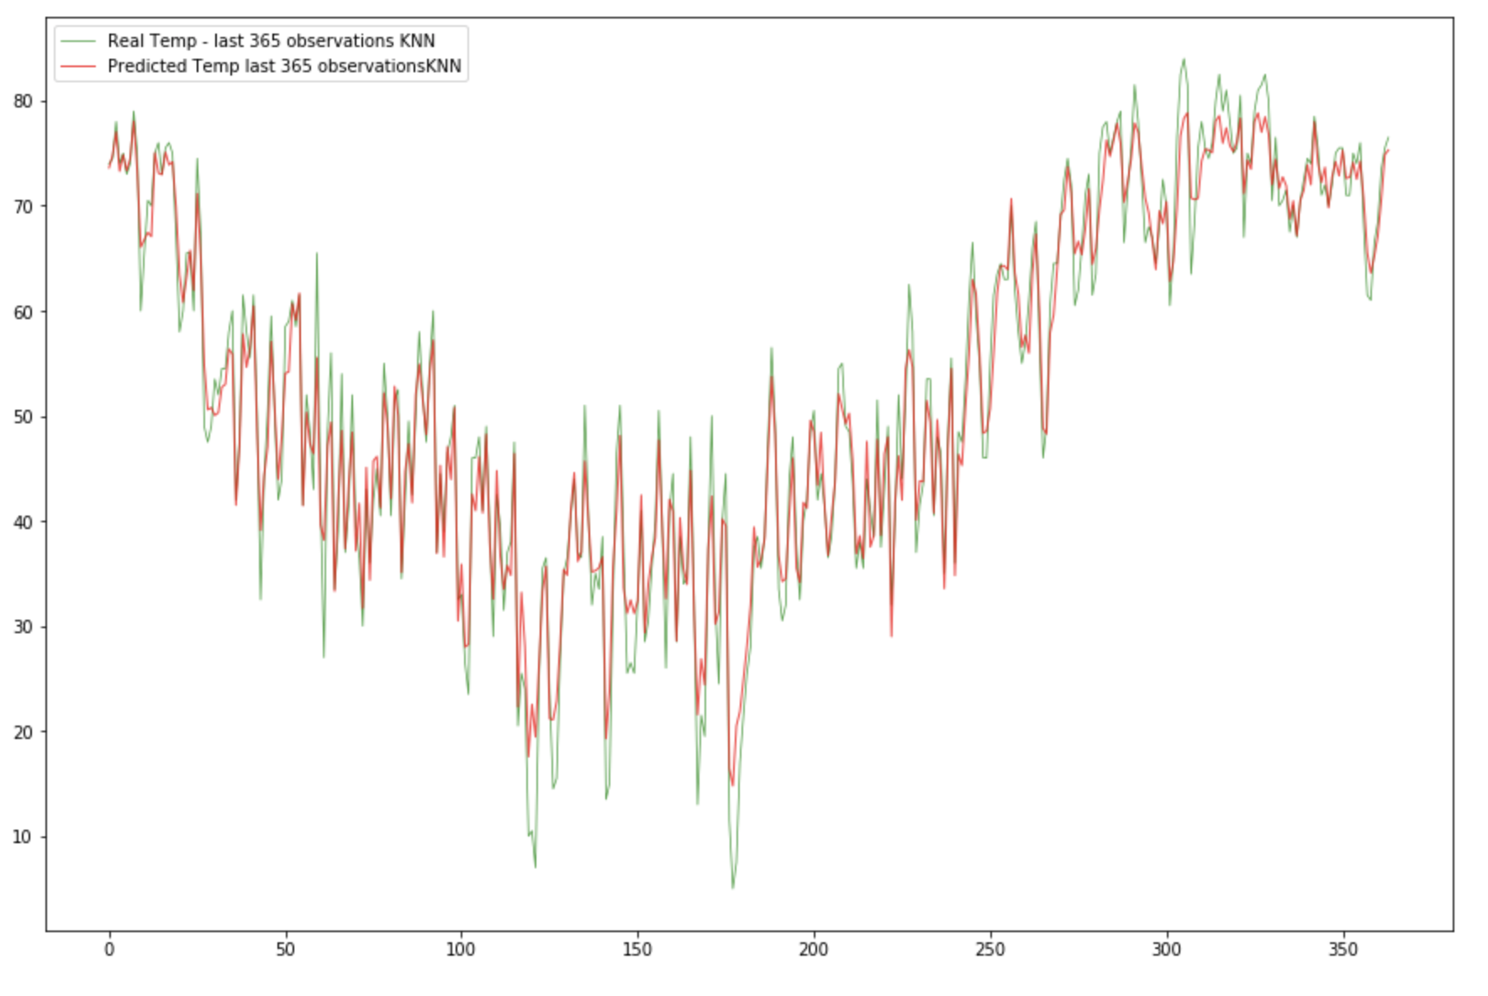
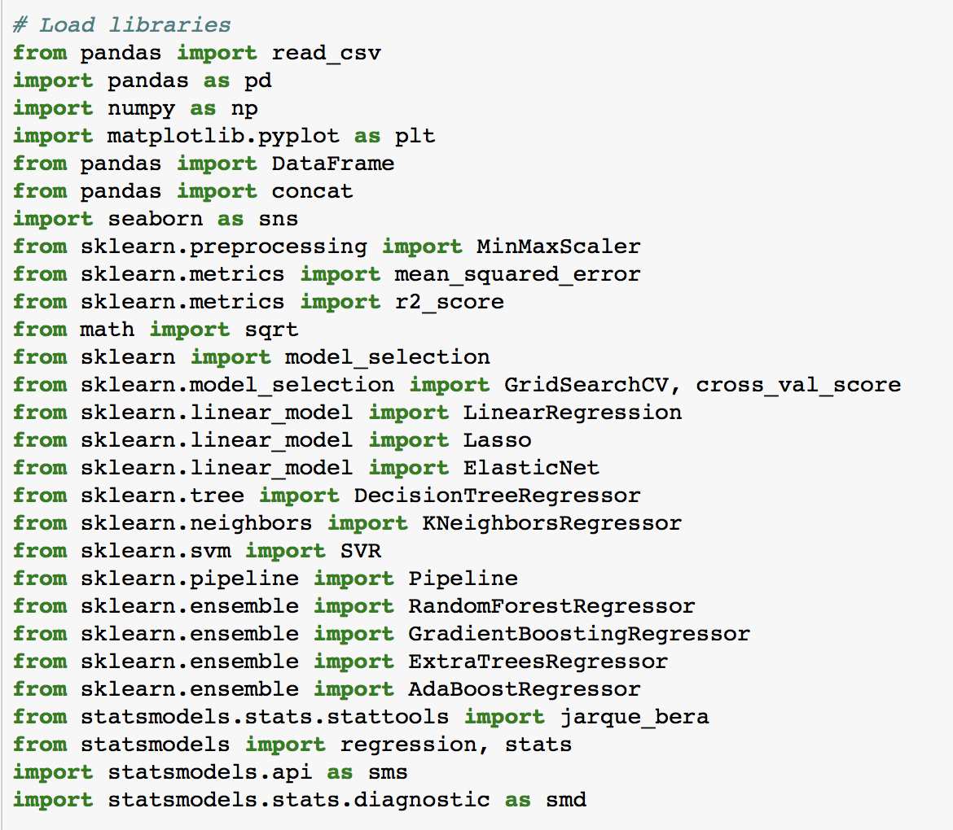
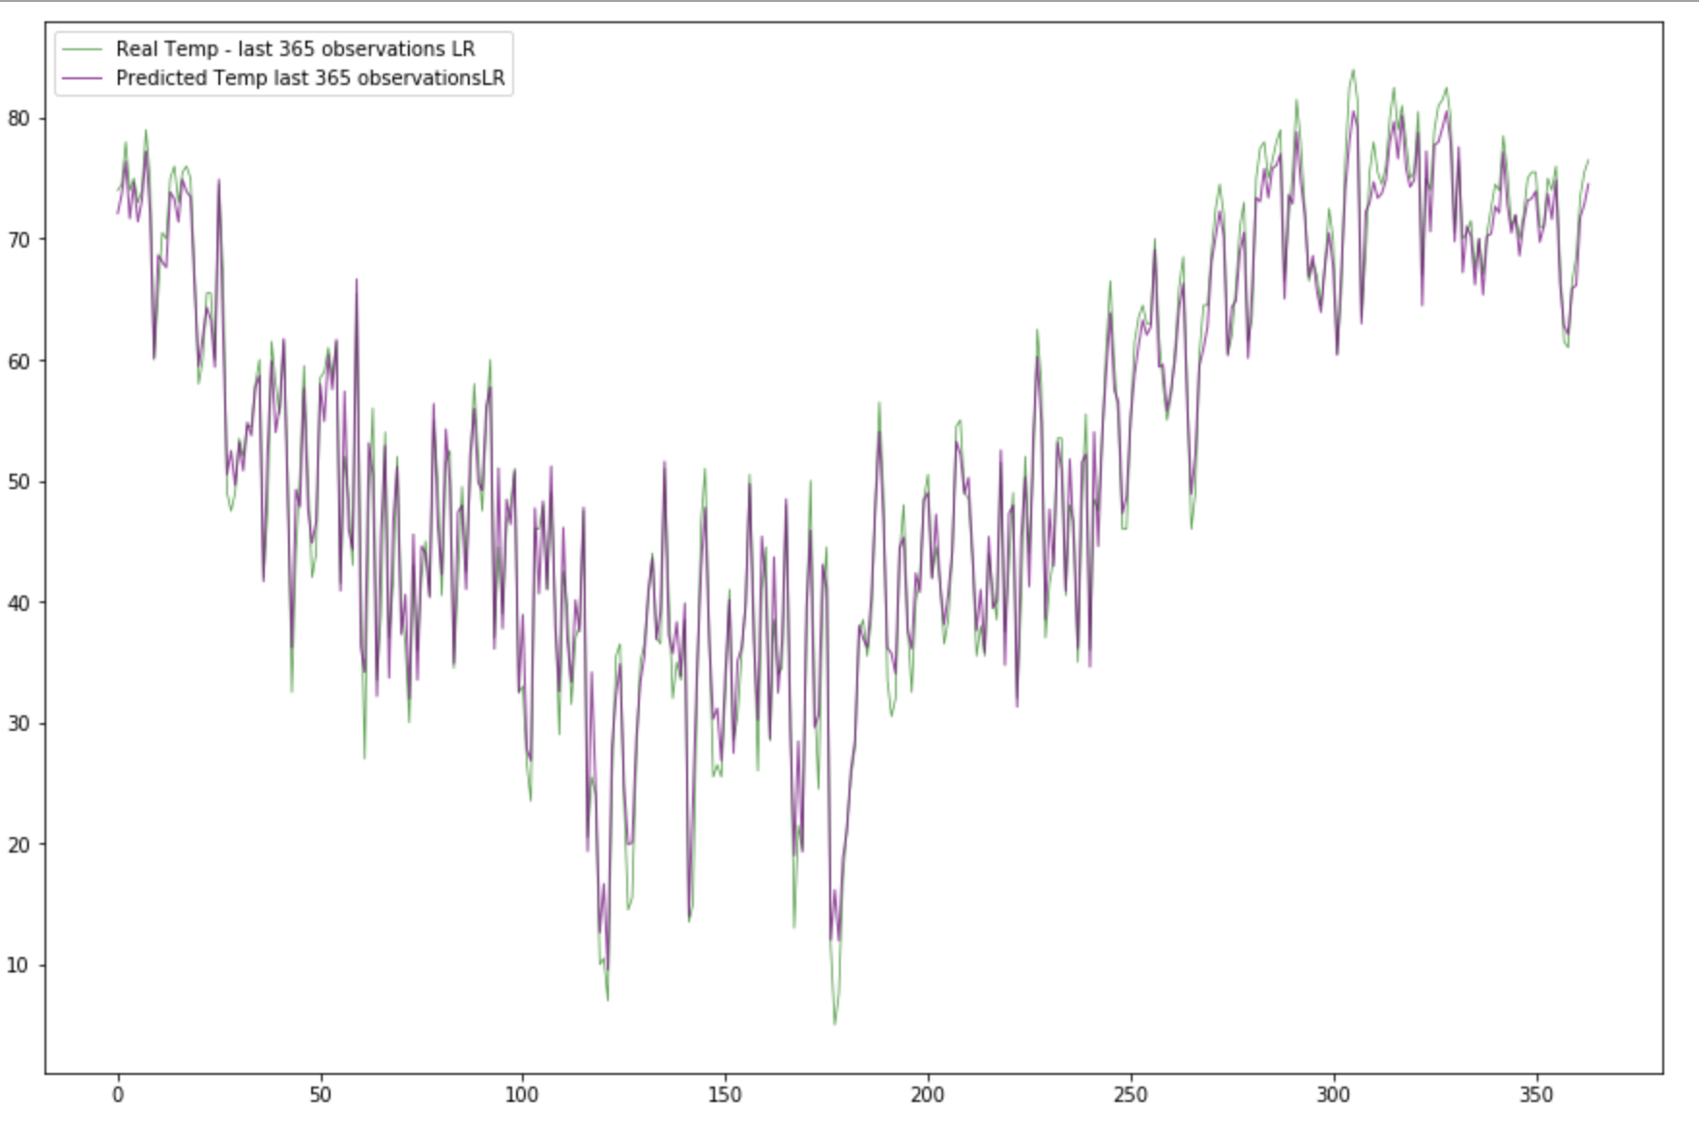
ML regressors to supervised problem
Model RMSE
KNN 7.826593
LR 7.926220
SVR 8.201007
Gradient Boost 8.391480
Extra Tree 8.606520
Radom Forest 8.619871
AdaBoost 8.673757

Slide 13
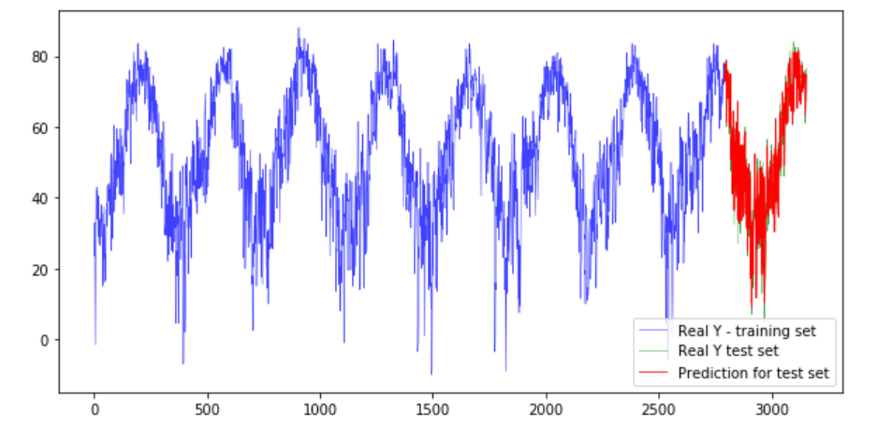
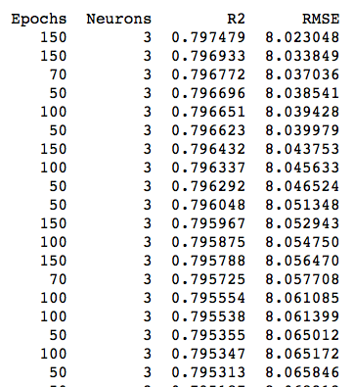
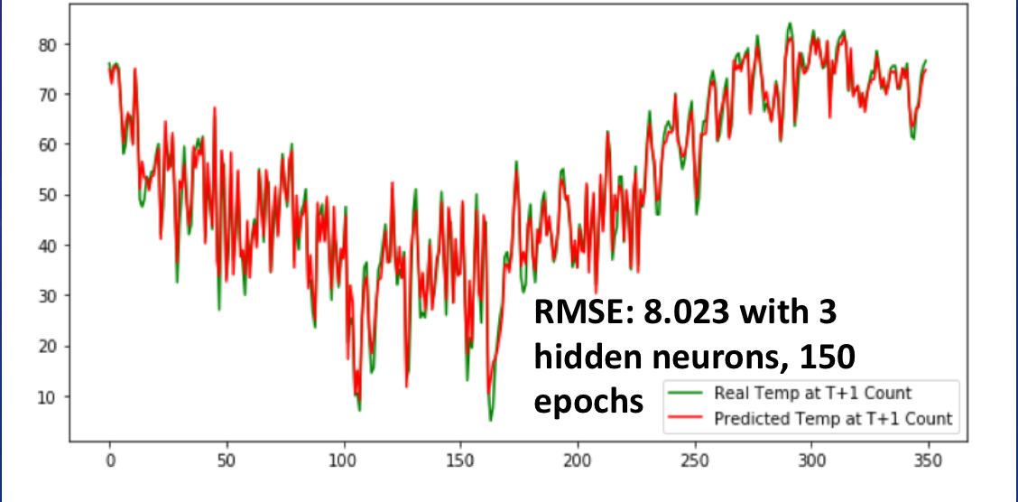
TIME series – Neural Networks - MLP
After experimenting with different number of epochs, neurons and batches:
Here are the results with 3 hidden neurons, different number of epochs, batch size of 4.
Done with data differencing, standardization , and using 3 lags
from keras.models import Sequential
from keras.layers import Dense
from math import sqrt

Slide 14
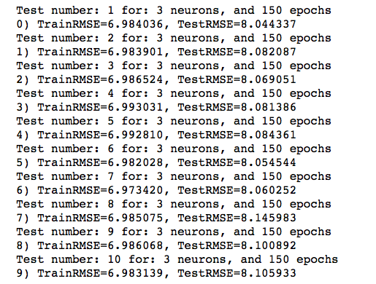
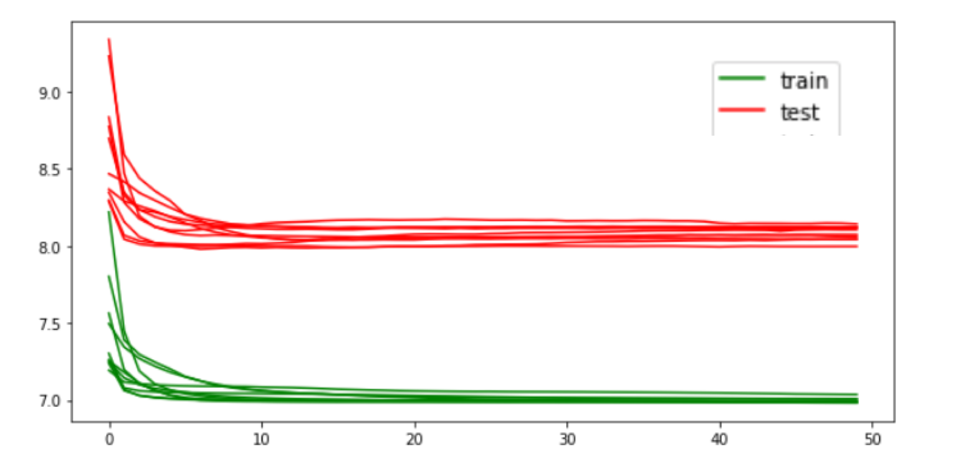
TIME series – Neural Networks - MLP
Diagnostic test for 3 neurons, 150 epochs

Slide 15
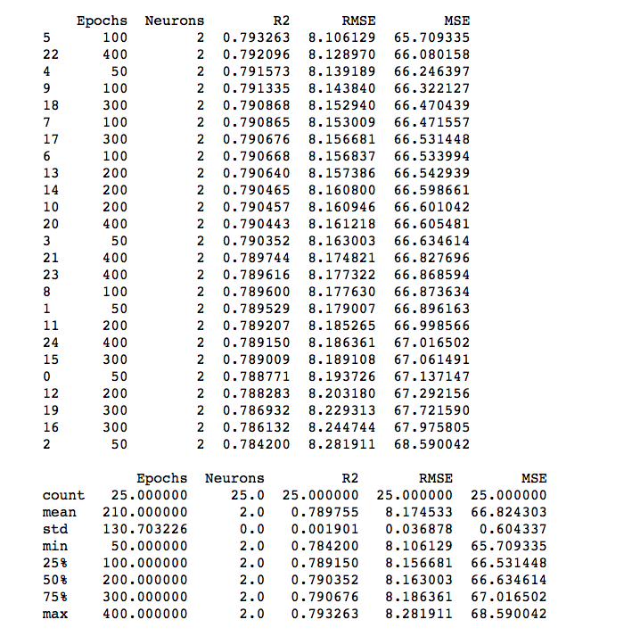
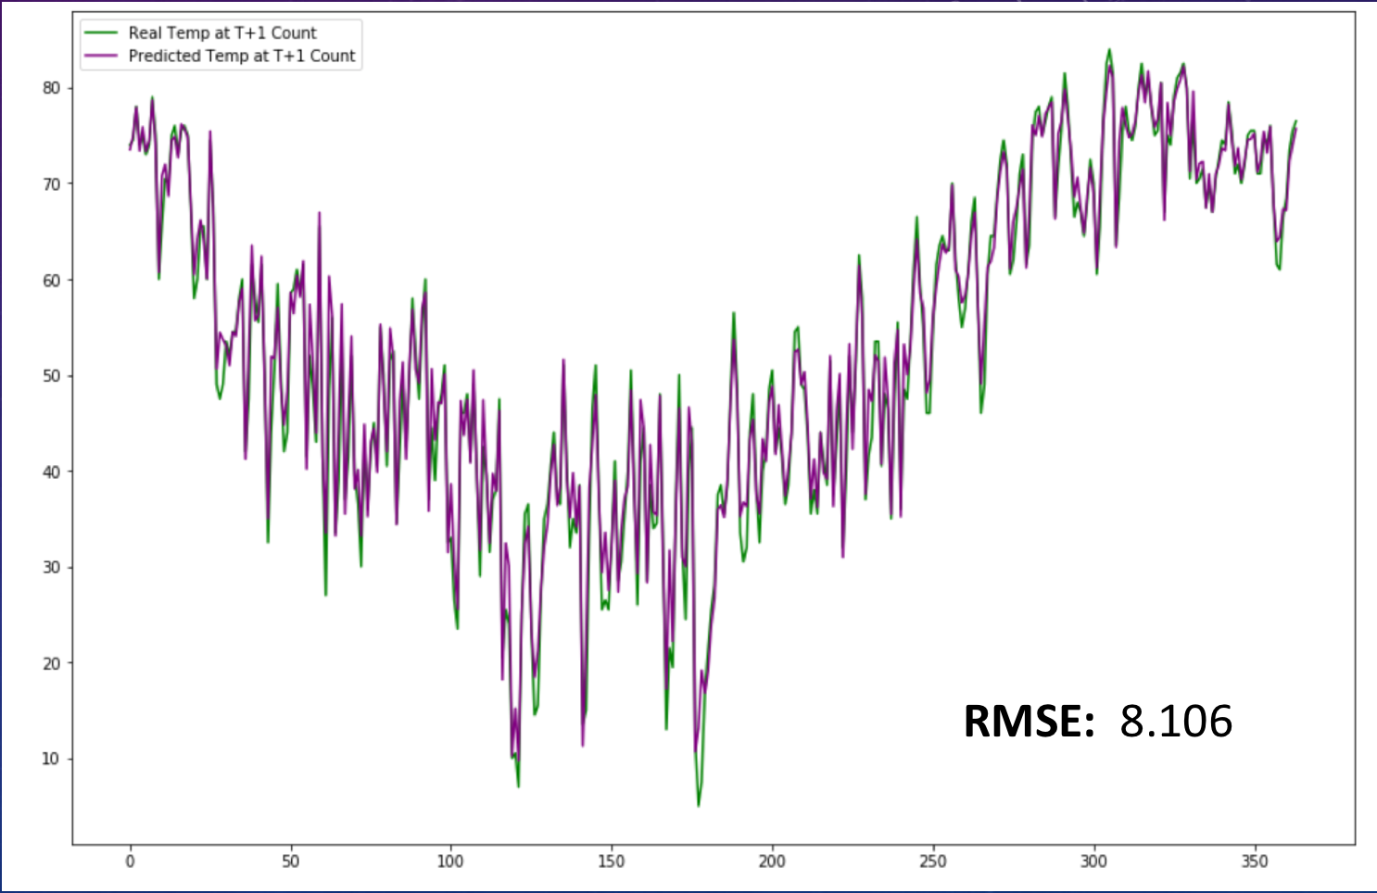
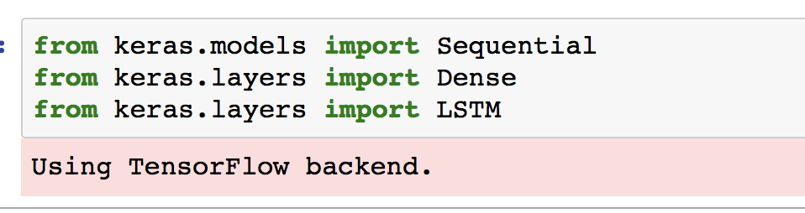
TIME series – Neural Networks – long-short-term memory (LSTM)
After experimenting with different number of epochs, neurons and batches:
Best Results: Neurons: 2 – Epochs: 150 – Batch size: 4
Done with data differencing, standardization , and 3 lags

Slide 16
Model | Test Set RMSE Validation | Language
Prophet | 8.97 | R
Linear Model | 9.05 | R
Decision Tree | 9.32 | R
LOESS – STL | 9.80 | R
SVM Regression | 10.50 | R
Arima (3,0,0) | 13.04 | R
Turned into Supervised
K Neighbors Regressor | 7.82 | Python
Linear Regression | 7.92 | Python
MLP (NN) Multi Layer Perceptron | 8.02 | Python
LSTM (RNN) Long Short Term Memory | 8.10 | Python
Support Vector Regressor | 8.20 | Python

Slide 17
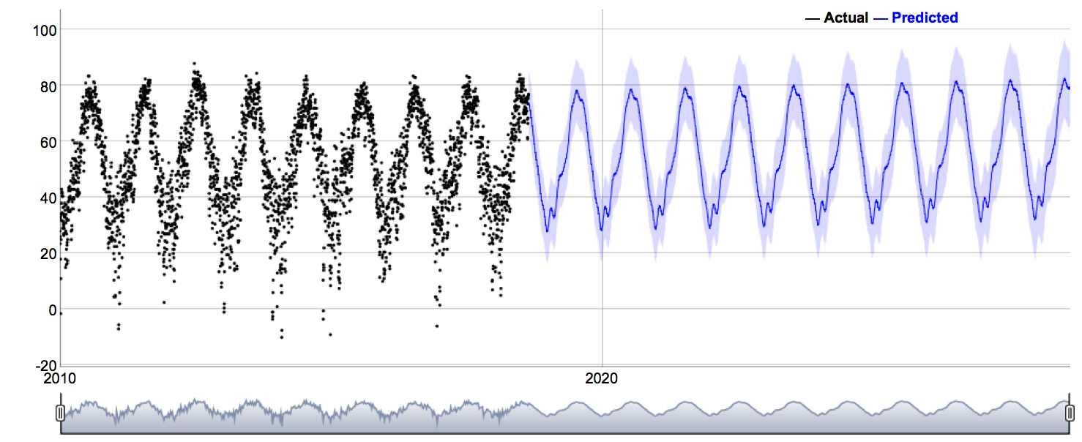
Prophet 10 year forecast

Slide 18
THANK YOU!

